Slide 1
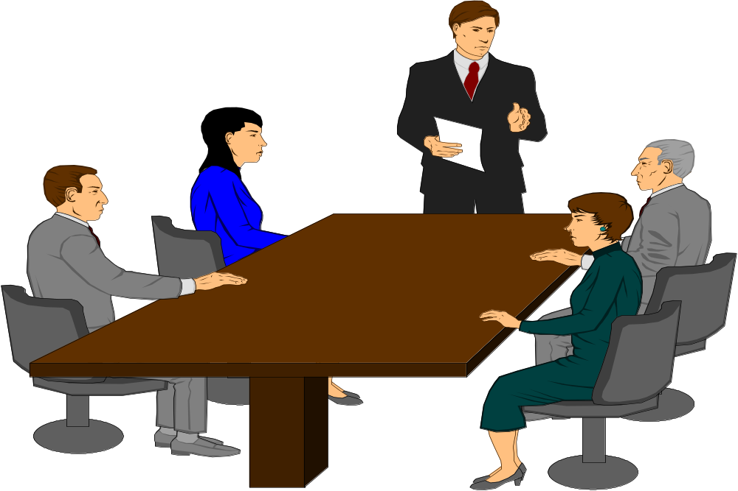
Working in Teams

Slide 2
Objectives
Be able to define team structure
Develop a team process
Learn about team culture

Slide 3
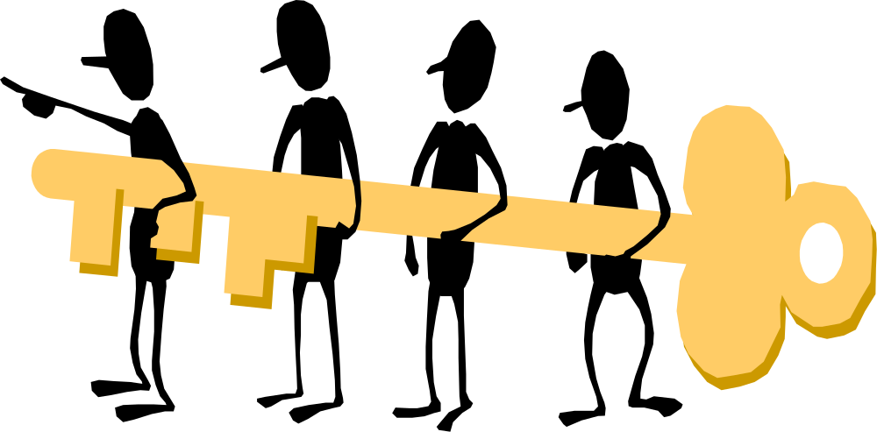
Team Structure
What type of team?
What is the purpose of the team?
Who is the leader of the team?

Slide 4

Types of Teams
Work Teams
Task Teams
Management teams
Notes:
Work team: a groups of people who work together to achieve a central goal. The goals of workplace teams can vary quite a bit.
Task team: a group of people joined temporarily or permanently to accomplish some task or to be engaged into some project (collective action).
Management team: a group of high-level associates hired by a business owner to take on essential responsibilities within the business. These individuals make up the highest levels of management within a company or business, and each specializes in a different area of managing a business.

Slide 5
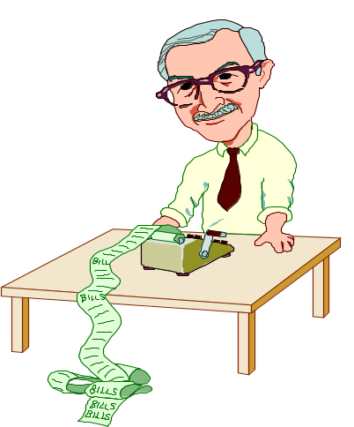

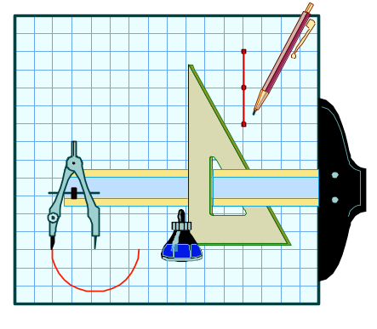
Team Structure
Team Size
Team
Membership
Team Skills
Stability of
the team

Slide 6
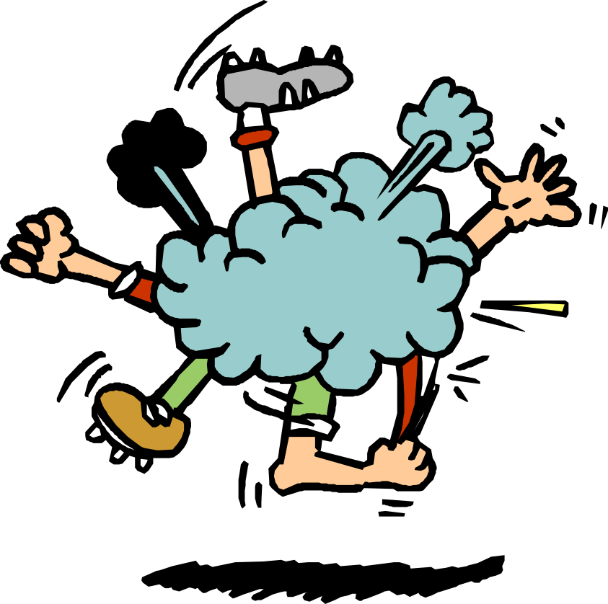
Purpose of the Team
What is the purpose of the team?
Each member
must understand
Team members
interest

Slide 7
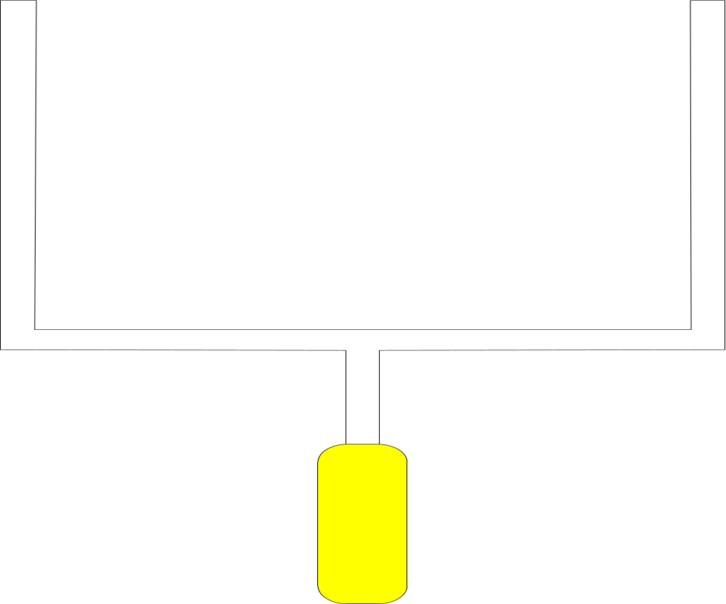
Goals
Once the team’s purpose is clarified,
team members must set the goals
the team wishes to accomplish!

Slide 8

Team Process
Adjustment
Development
Cohesion
Formation
Reinforcement
Definition
Renewal
Learning
Transformation

Slide 9
Formation
First meeting of the team
Define what they need to accomplish and how the team will operate
Develop measures for short and long term success
  Having short term goals
  Long term is the ultimate purpose
Establish ground rules of operation

Slide 10
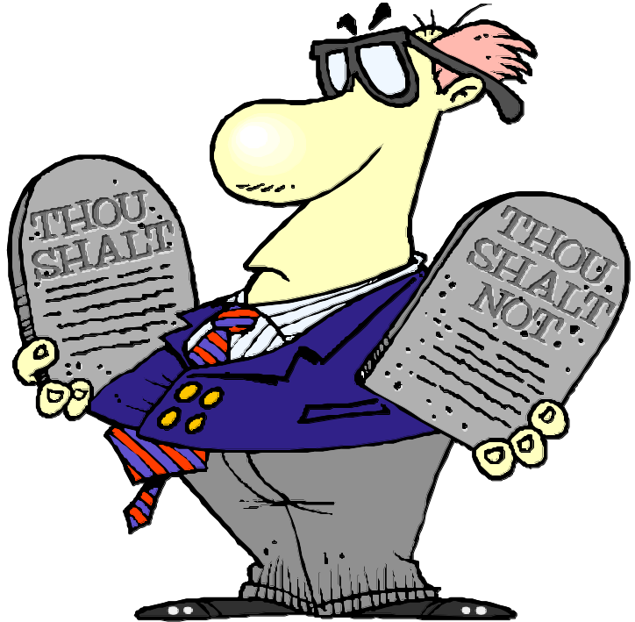
Ground Rules
When and where the team meets
Substitutes allowed at meetings
Team records, what,who,how
Work expectations
of members
Confidentiality
Participation…...

Slide 11
Verbal Behaviors
What behaviors encourage effective participation
  Set context
  Ask questions of members
  Use supportive statements
  Seek out different perspectives
  Share feelings

Slide 12
Contributor Skills
Initiation - draw out information, clarify ideas
Energize - show enthusiasm, engage in team process, show commitment
Organize
Build relationships
Be flexible
Learn

Slide 13
Adjustment
Revisions of the initial rules and goals
A reality check of what can be accomplished
Tensions usually come up here, must reach consensus, usually about personalities
Breakpoint comes when the team gets mired in discussions about what to do and who should do what...

Slide 14
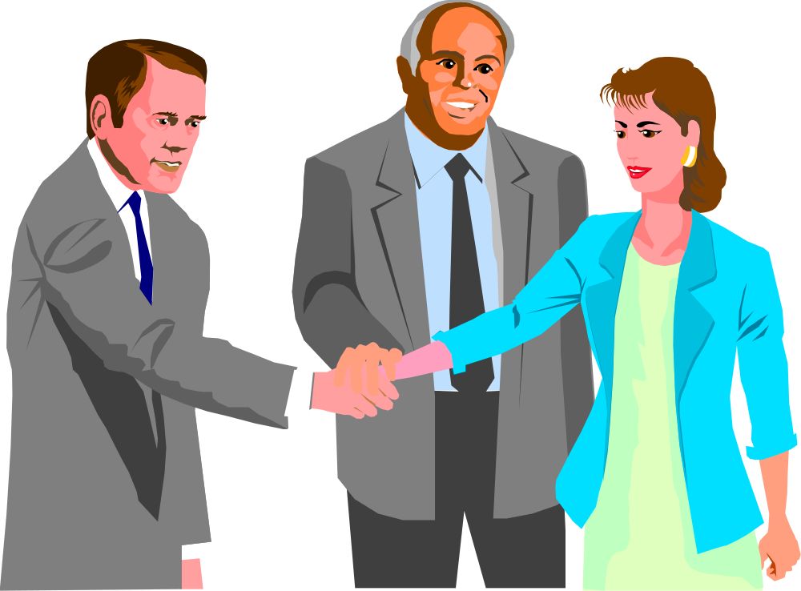
Development
Cohesion
Reinforcement

Slide 15
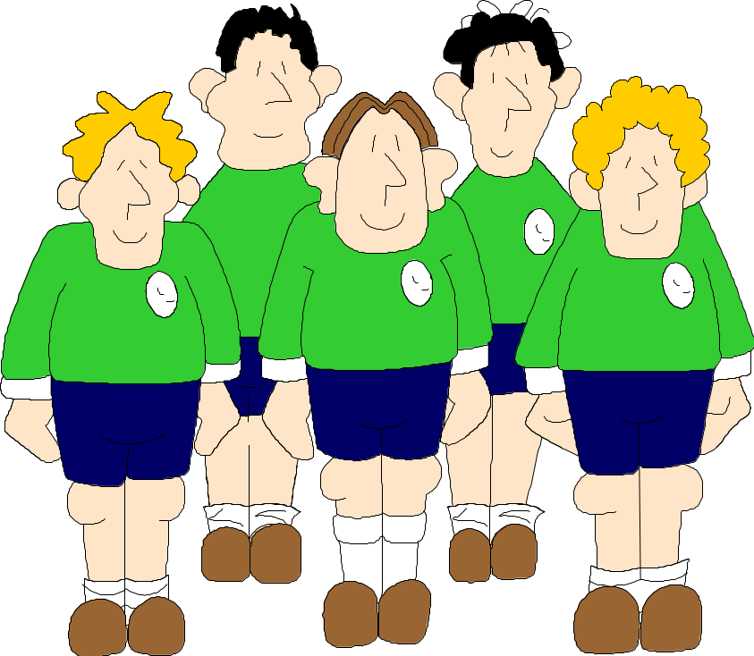
Cohesion
Comes together as a team
High energy
High interest
Progress is made
Team is supportive
Develop relationships

Slide 16
Reinforcement
Cohesion builds
Team members are comfortable with each other
Start to be interested in self-preservation and self-perpetuation
Goals should be on creativity and exploration

Slide 17
Renewal
Learning
Transformation

Slide 18
Learning
Team learns new skills
Build relationships to accomplish task
Commitment and mutual accountability
Now, team may be confrontational over issues

Slide 19
Transformation
Results are produced from team activities
Innovative
To sustain energy, must stress and press the team
Needs new challenges, new members, new tasks, new relationships or…...

Slide 20
Team Learning
Continuous improvement process
How team resolves conflict
How the team handles diversity
Harness team creativity

